Slide 1
Digital Image & Low-Level Processing

Slide 2

What is a Digital Image?
A digital image is a picture stored in a computer as numbers.
It is made of small dots called pixels.

Slide 3
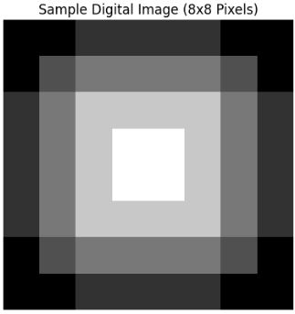
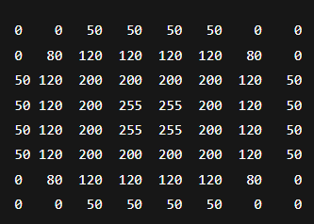
What is a Pixel?
Pixel = smallest unit of an image.
Pixel value shows brightness:
0 → Black
255 → White

Slide 4
What is Sampling?
Sampling means dividing an image into small dots called pixels.
It decides how many pixels an image has.

Slide 5
Why Sampling is Needed?
Computers work only with discrete data.
Sampling converts a continuous image into pixels.
This makes storage and processing possible.

Slide 6
Sampling Example
Low sampling:
Fewer pixels → Blurry image
High sampling:
More pixels → Clear image

Slide 7
What is Quantization?
Quantization means assigning a number to each pixel.
It decides the brightness levels of pixels.

Slide 8
Why Quantization is Needed?
Infinite brightness values cannot be stored.
Quantization limits brightness to fixed levels.
This saves memory and processing time.

Slide 9
Quantization Example
Low quantization:
Few brightness levels → Rough image
High quantization:
Many brightness levels → Smooth image

Slide 10
Sampling vs Quantization
Sampling:
• Number of pixels
• Affects clarity
Quantization:
• Pixel values
• Affects smoothness

Slide 11
Simple Robotics Example
Robot camera captures an image.
Sampling decides resolution.
Quantization decides brightness quality.
Sampling and quantization convert real-world images into digital images for computer vision

Slide 12
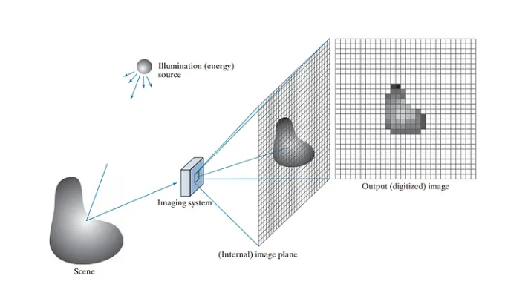
Digital Image Formation
Digital image formation is the process of converting a real-world scene into a digital image.
Object → Light → Camera → Sensor → Numbers → Digital Image

Slide 13
How Digital Image is Formed
1. Light falls on object
2. Light enters camera
3. Sensor converts light to signals
4. Signals become numbers
5. Digital image is created

Slide 14
What is Low-Level Image Processing?
Low-level processing works directly on pixels.
Input: Image
Output: Improved image

Slide 15
Examples of Low-Level Processing
Brightness adjustment
Noise removal
Blurring
Sharpening
Contrast enhancement

Slide 16
Simple Robotics Example
Robot camera captures a dark image.
Brightness is increased.
Noise is removed.
Image becomes clear.

Slide 17
Why Low-Level Processing is Important
Improves image quality
Removes noise
Helps robots see clearly

Slide 18
Brightness Adjustment
Pixel values are increased or decreased.
Example:
100 → 150 (brighter)
Used for dark images.

Slide 19
Noise Removal
Unwanted dots (noise) are removed.
Method:
Average nearby pixels.
Result: Clean image.
120 200 130
120 130 130(After noise removal)

Slide 20
Blurring
Pixels are averaged to smooth the image.
Used to:
• Reduce noise
• Remove small details
Sharp edges -> Smooth edges

Slide 21
Sharpening
Edges are enhanced.
Result:
Clear object boundaries.
Edges look soft-> Edges look clear and bold

Slide 22
Contrast Enhancement
Difference between dark and bright regions is increased.
Result:
Better visibility.
All pixels between 100–140 -> Spread to 0–255
Foggy image
After contrast enhancement → details visible

Slide 23
Simple Robotics Example
Robot camera image is dark and noisy.
Brightness is increased.
Noise is removed.
Robot sees clearly.

Slide 24
Summary
Brightness → Light/Dark control
Noise removal → Clean image
Blurring → Smooth image
Sharpening → Clear edges
Contrast → Better visibility

Slide 25
Conclusion
Digital images are numbers.
Low-level processing improves images.
First step in Computer Vision.

